Slide 1
METASPLOIT
1905016 - Zulkar Naim
1905024 - Rakib Ahsan
CSE 406 Security Sessional Project Presentation
Subsection A1, Group 1

Slide 2
What is Metasploit
A widely used open-source framework for penetration testing, vulnerability assessment, and security research.
Includes a large set of tools and resources to identify and exploit vulnerabilities in various systems.

Slide 3
Module
Exploit Module: Used for exploiting known vulnerabilities to gain unauthorized access to systems.
Payload Module: Code that is executed on the target system once an exploit is successful.
Auxiliary Module: Additional functionalities like scanning, fuzzing, and sniffing. These modules do not exploit vulnerabilities.
Post-Exploitation Module: Used after a successful exploit to perform actions such as data gathering and privilege escalation.
Encoder Module: These modules obfuscate the payload to evade detection systems like antivirus software.
Invasion Module: Custom category often used for advanced intrusion techniques.
NOP Module: Stands for ’No Operation’. These modules fill spaces in a payload, often for alignment purposes.

Slide 4
Demonstrated Attacks
Attack on Metasploitable 2 through FTP port
Windows XP MS17_010 exploit

Slide 5
Attack on Metasploitable 2 through FTP port

Slide 6
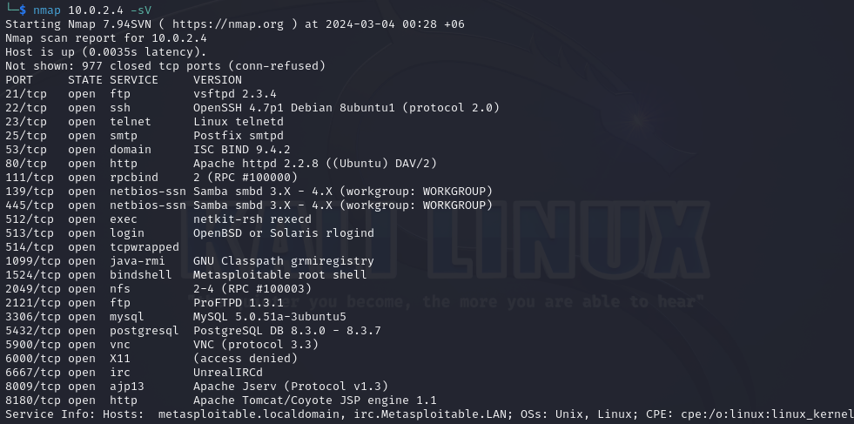

Slide 7
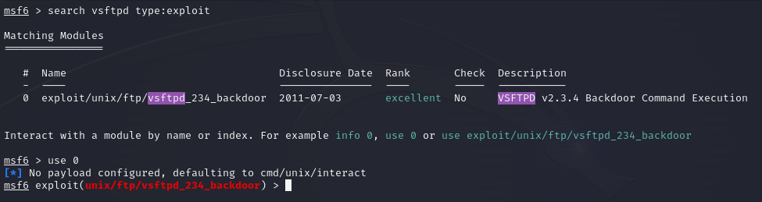
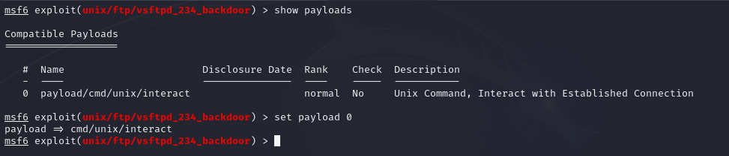

Slide 8
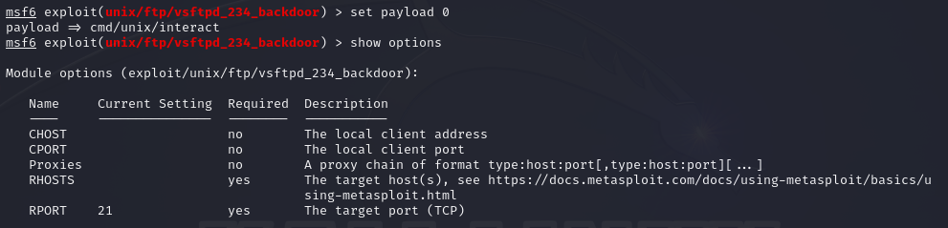
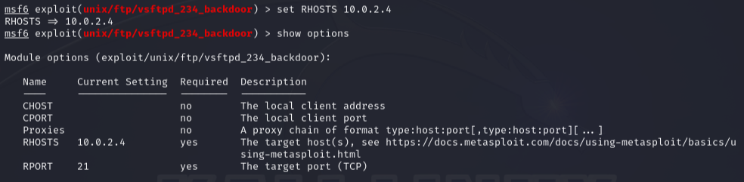

Slide 9
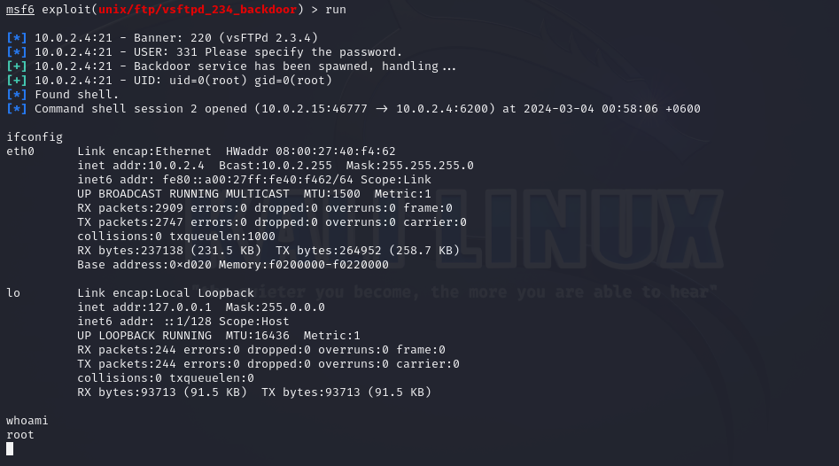

Slide 10
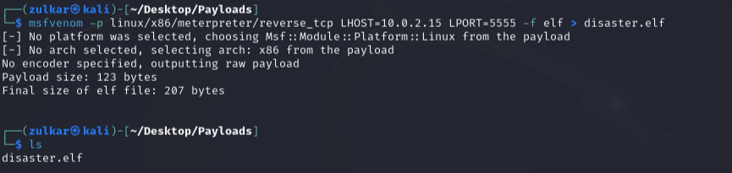


Slide 11
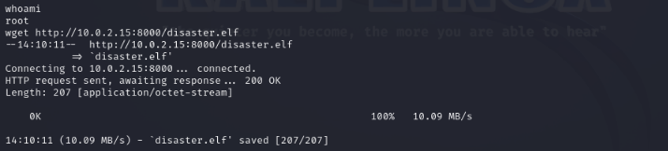

Slide 12
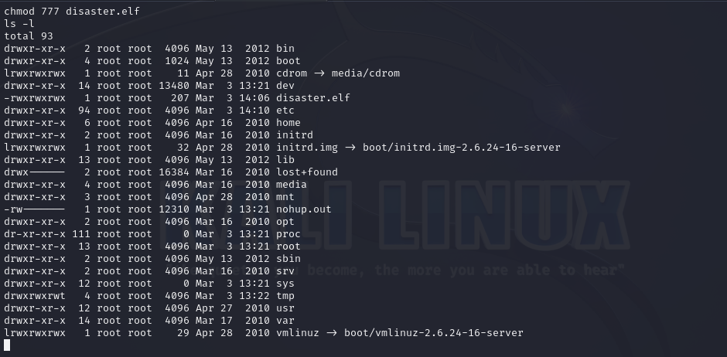

Slide 13
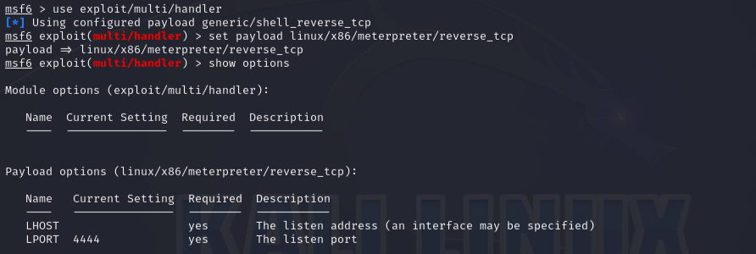
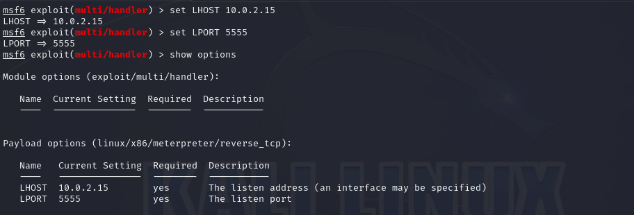

Slide 14

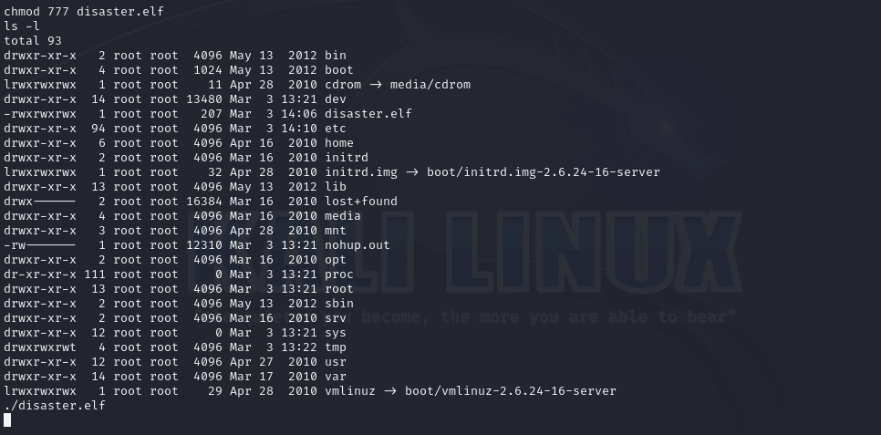

Slide 15

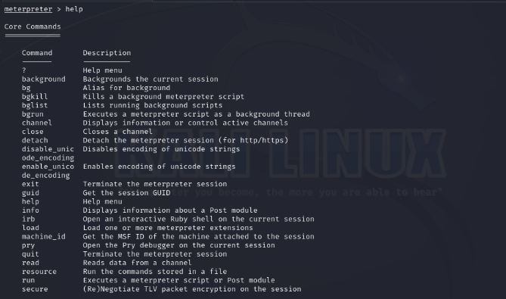

Slide 16
Windows XP MS17_010 exploit

Slide 17
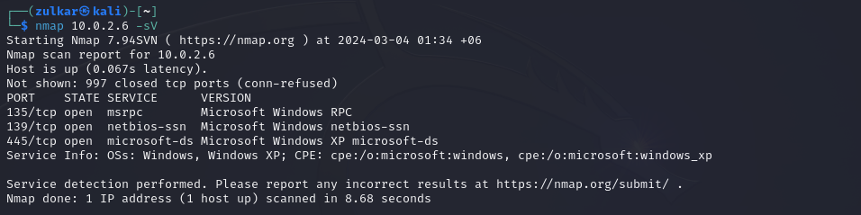

Slide 18
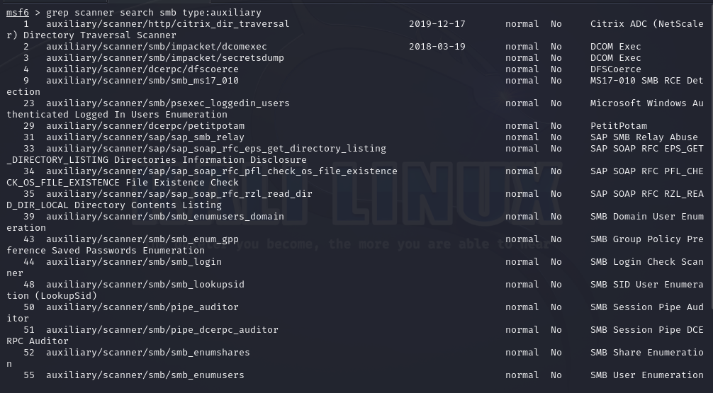

Slide 19
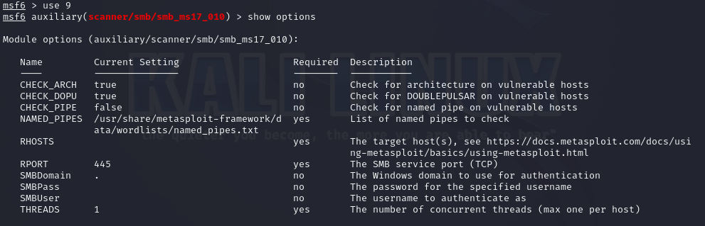

Slide 20
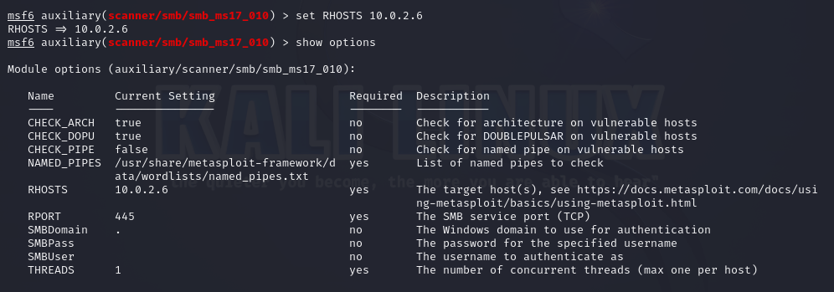
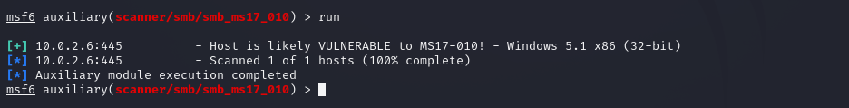

Slide 21
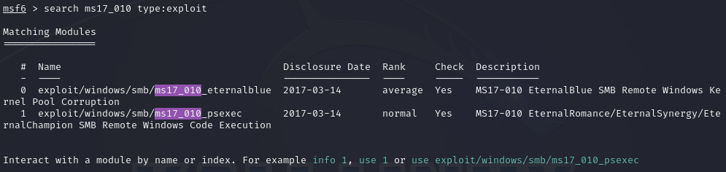

Slide 22
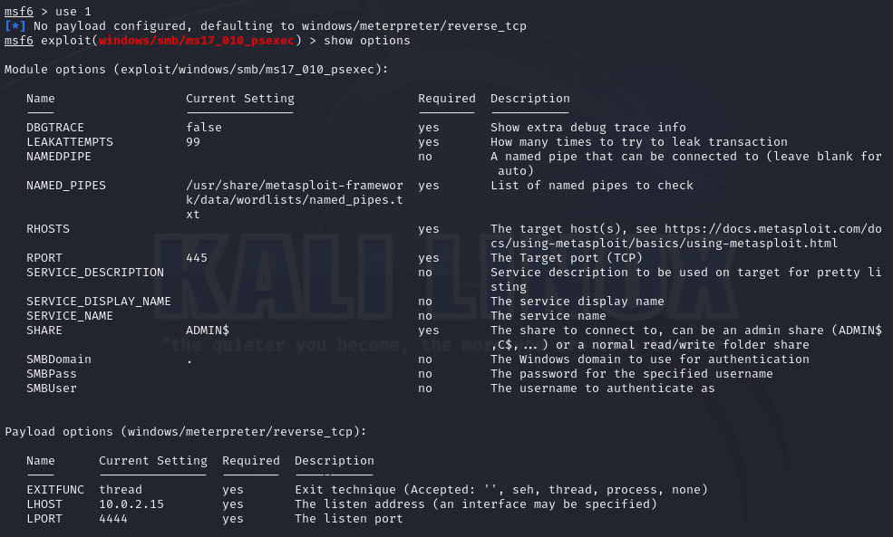

Slide 23
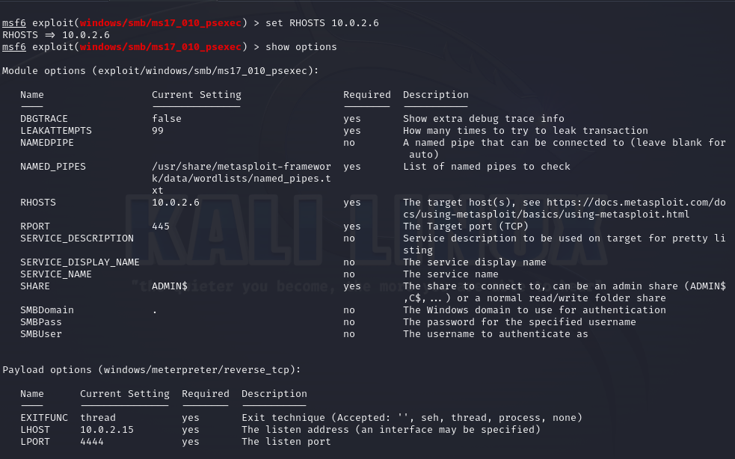

Slide 24
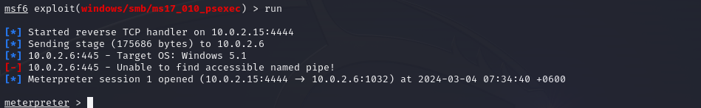
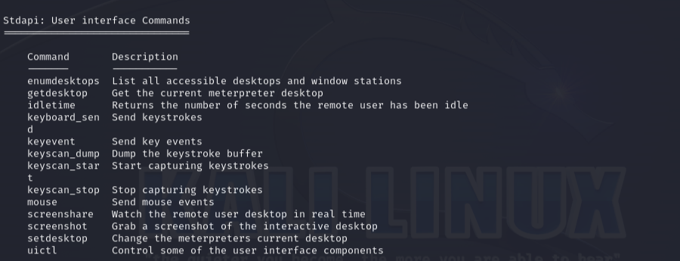

Slide 25
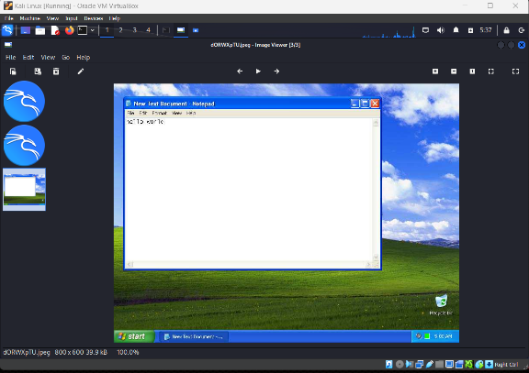

Slide 26
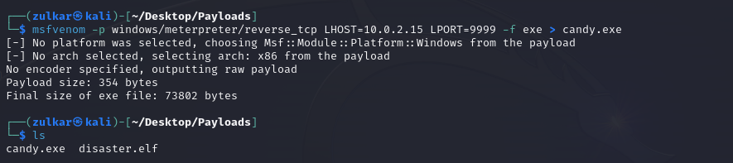
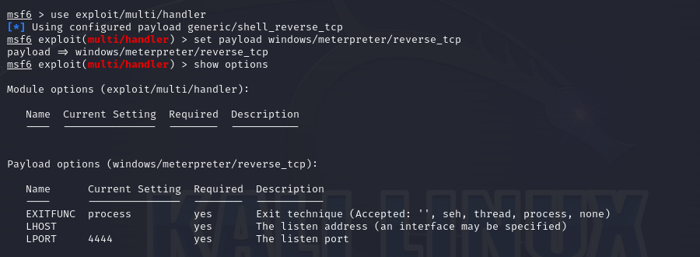

Slide 27
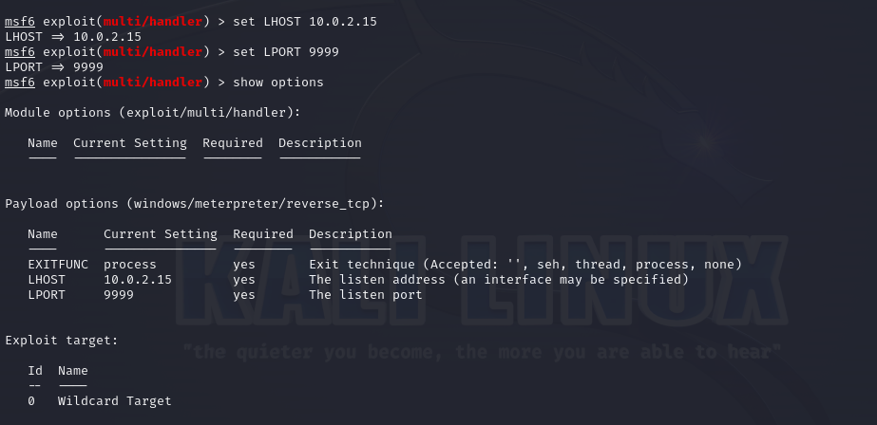

Slide 28
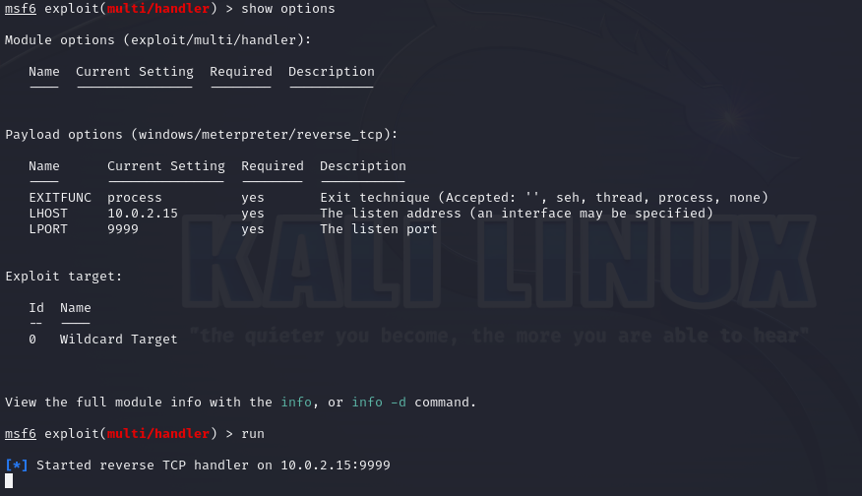

Slide 29
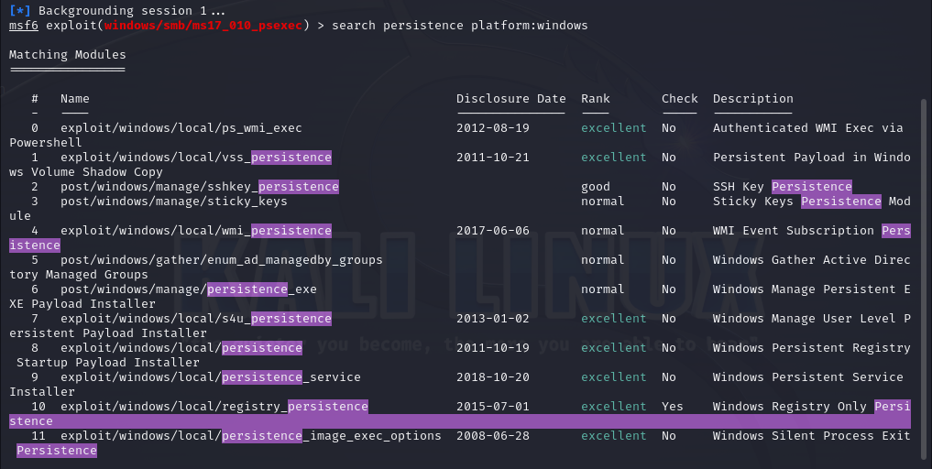

Slide 30
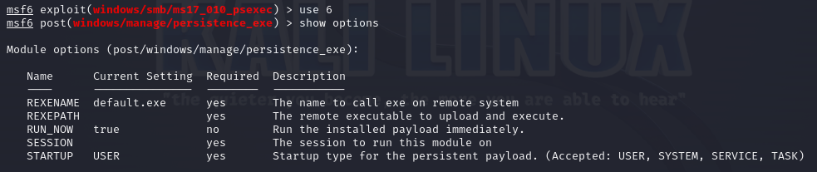
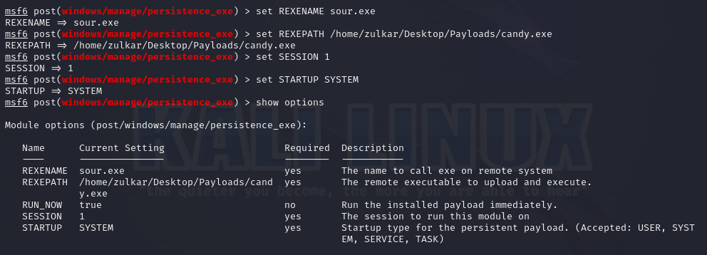

Slide 31
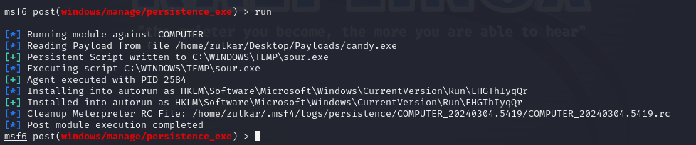
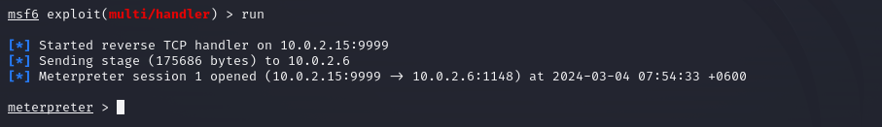

Slide 32
